Slide 1
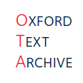

Linking in the TEI
LRBS 2025
Digital Editing

Slide 2
What is the concept of ‘linking’ in the TEI?
Linking is a way of representing non-linear and/or non-hierarchical structures in the TEI (see TEI Guidelines 17).
XML is an extremely flexible language, except for the fact that its elements must nest neatly inside of each other; when rendering texts in XML, this nesting structure translates as a hierarchical one, but not all texts behave that way.
Linking is a way to circumvent the constraints that XML imposes on the digital representation of texts.

Slide 3
Linking is good for …
Useful for dealing with non-hierarchical structures.
Can indicate when separate structures should be understood as being one structure – a.k.a. aggregation.
Useful for discourse analysis that focuses anaphoric structures.
Useful for texts that correspond to one another in some way.
Translations.
Footnotes.
Hypertext.

Slide 4
Linking and Translation

Slide 5
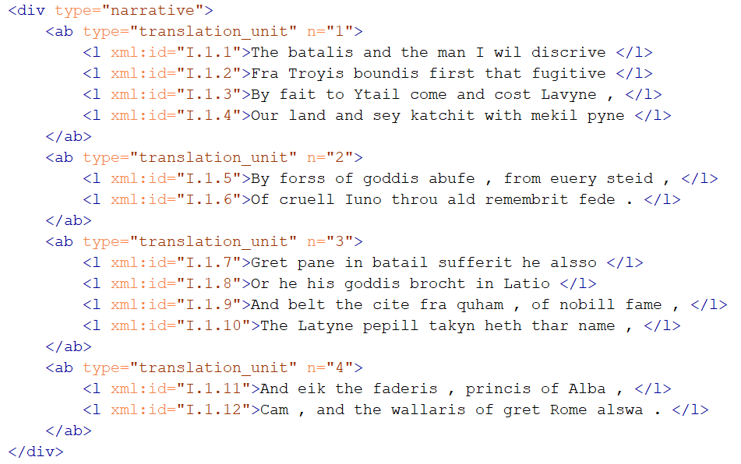
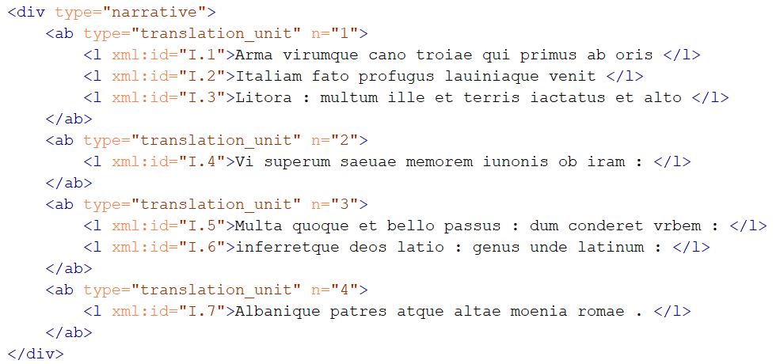
What does it look like? Separate documents
Translation
Source

Slide 6
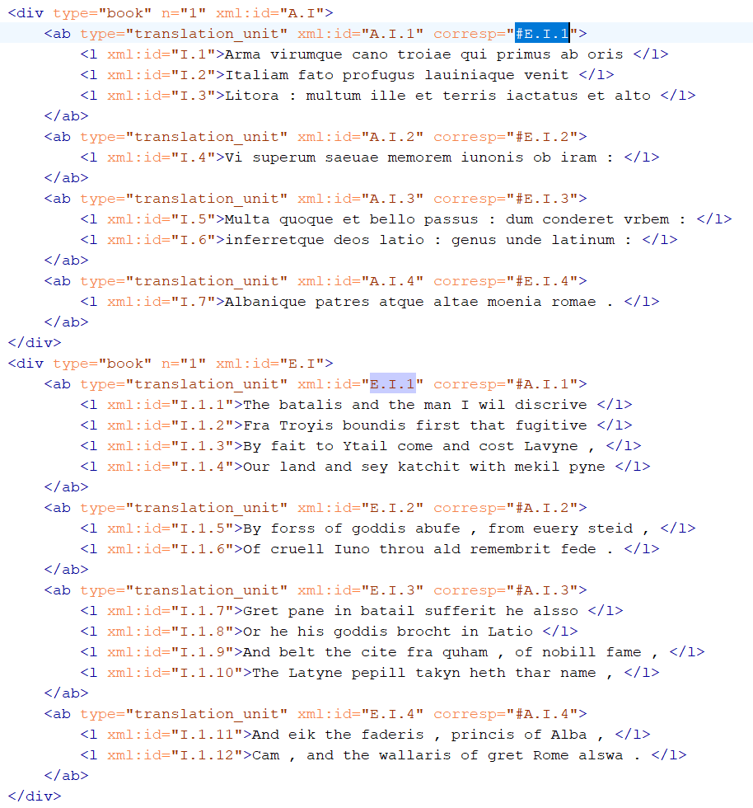
What does it look like? Corresp method

Slide 7
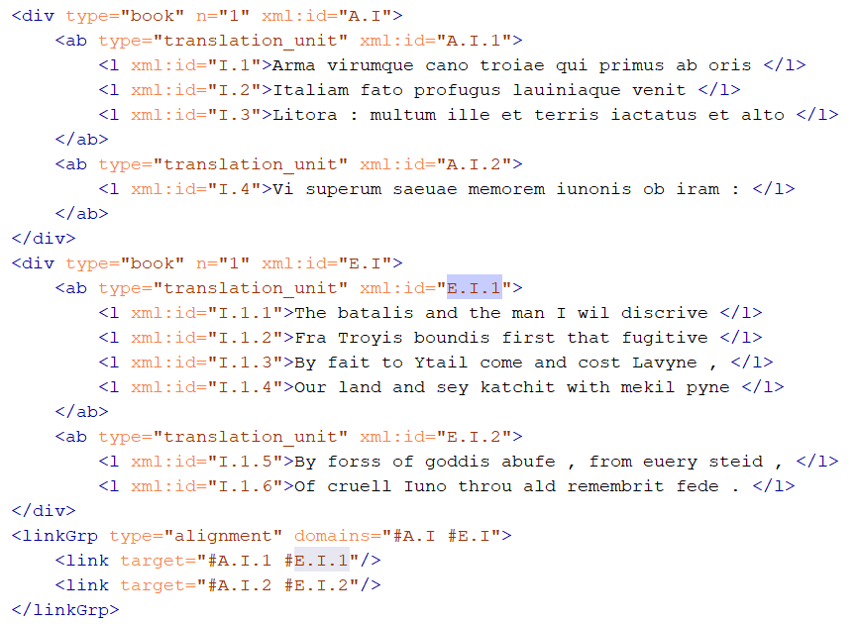
What does it look like? Link groups

Slide 8
Linking and Aggregation

Slide 9
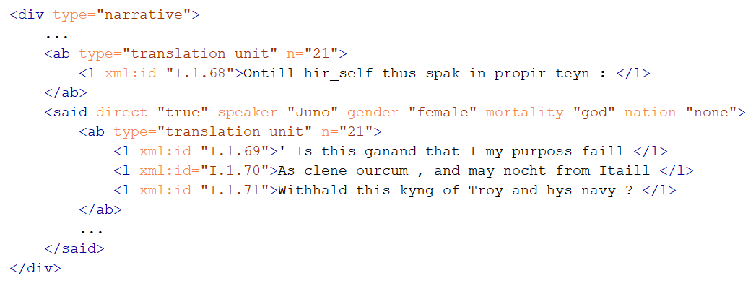
What does it look like? Shared ID numbers

Slide 10
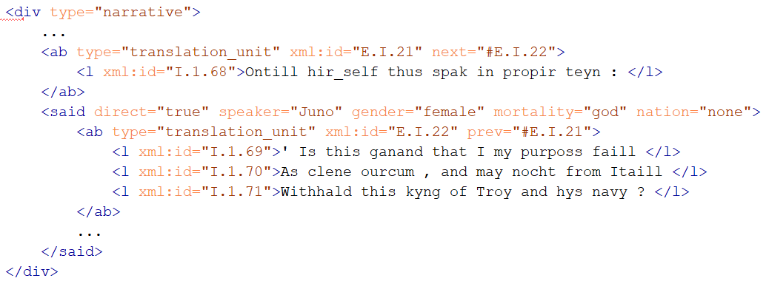
What does it look like? Next and Prev

Slide 11
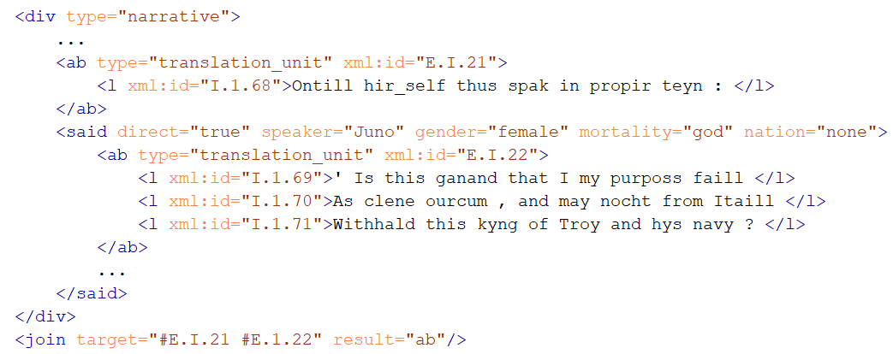
What does it look like? Join method

